Slide 1
Project Capstone 9th April 2020
Analysis of the optimal location for new restaurants in Singapore
Link to notebook: https://github.com/serenalees0/final_capstone/blob/master/Battle%20of%20Neighbourhood%20FINAL%20.ipynb

Slide 2
Business Problem / IntroDUCTION
Singapore is a small country with a very competitive market for the food and beverage business.
According to the 2016 Singstat.gov.sg report, there are 7,679 food establishments in Singapore.
Given that operating cost is high for such business, it is vital for those who are keen to open up a new restaurant to consider certain factors like rental or location of the restaurant. As the choice of location is an important decision for prospective restaurateur, this report will analyse the optimum location in Singapore for them to consider opening their restaurant at.

Slide 3
DATA EXTRACTION
Information on towns and population with latitude and longitude are downloaded. This is readily available from Data.gov.sg portal (https://data.gov.sg/dataset/estimated-resident-population-living-in-hdb-flats). The latest data available is based on 2018 figures so we will focus on the population numbers in 2018.

Slide 4
METHODOLOGY
Data clean up
Foursquare API to explore neighbourhood towns to get the most common venues in each town as well as the restaurant type.
k-means clustering algorithm was chosen for the analysis.
Folium will then be used to visualise the neighbourhoods and the clusters.
getNearbyVenues will be used to extract Venue Id, Venue Name, Coordinates and Category Name for the dataframe.
getVenuesByCategory will be performed for Category ID: 4d4b7105d754a06377d81259 (Food Venues) which we will be able to retrieve the information on the most common food venues for each neighbourhood towns.
k-means clustering algorithm was chosen for the analysis.
Folium will then be used to visualise the neighbourhoods and the clusters.
One Hot Encoding is also used to analyse each town’s nearby venues.

Slide 5
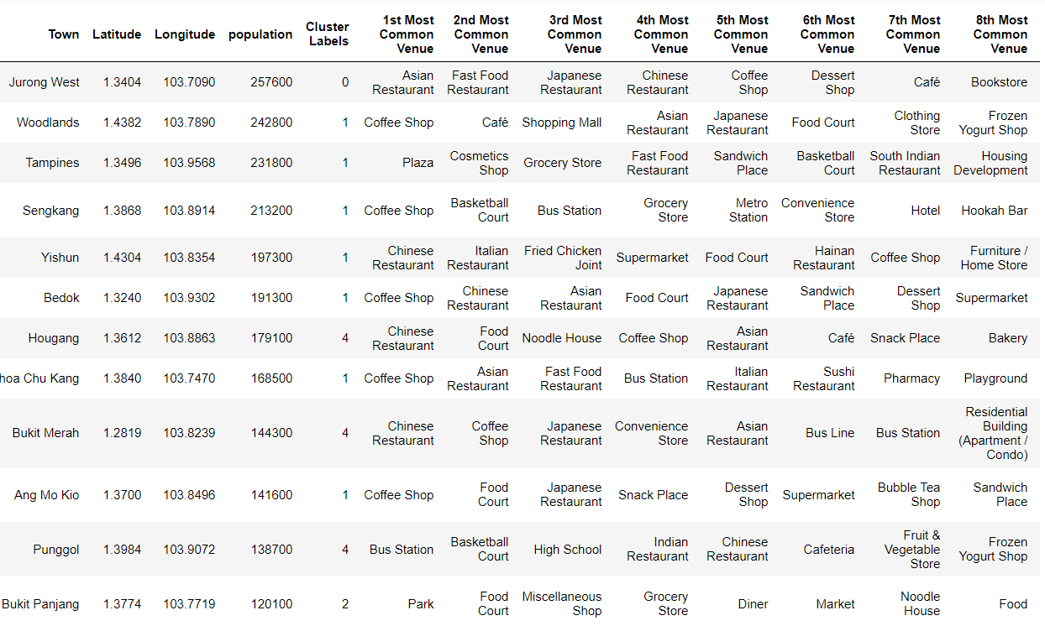
RESULTS
2 categorised tables are churned
Table A - Most Common Venues in the Neighbourhood:

Slide 6
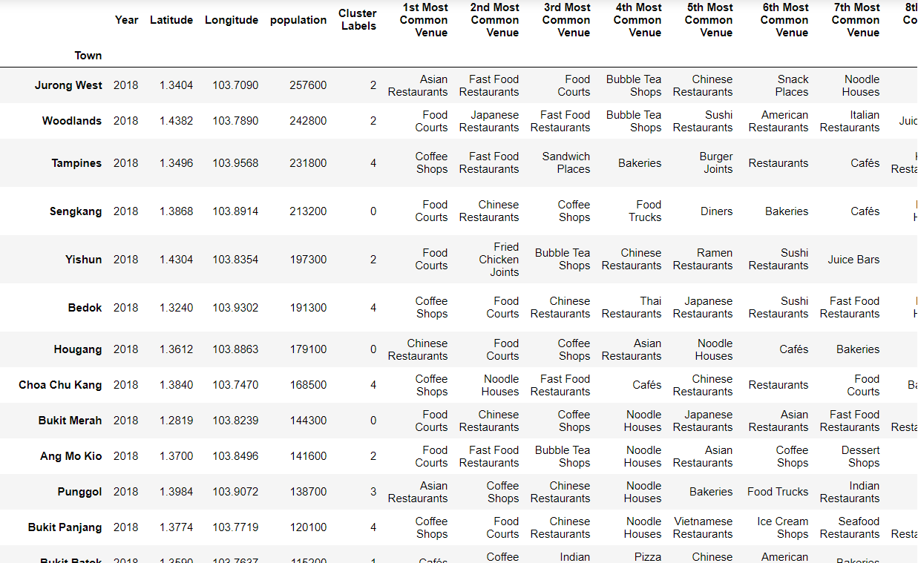
RESULTS - continued
Table B – Most Common Food Venues in the Neighbourhood

Slide 7
CONCLUSION
Potential restaurant owners may wish to consider to open their eateries based on the following factors:
-location to be a town where the population is one of the highest.
-although Jurong West is the most populous town in Singapore, their top 7 venues are all food-related establishments, which would mean it is too competitive to open any restaurants there at the moment. Other towns with less common food venues should be considered.
-The 2nd result table also shows the type of food establishments are most common in each town. It is not advisable for prospective owners to open another similar type of restaurant in a town where it is most commonly available to avoid competition (e.g. Asian Restaurants in Jurong West)
The above provides a general guide to prospective restaurant owners on the town and restaurant type that owners can consider or avoid. However, there are also many other factors to consider that are not discussed in this analysis for sake of simplicity.

